Slide 1

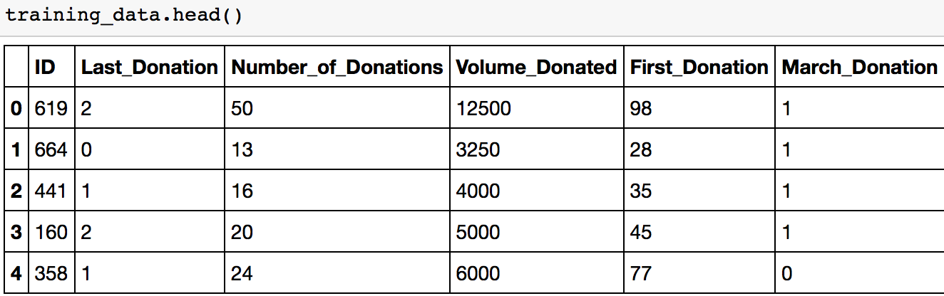
Driven Data: Blood Donor Predictions
What is the Data Science Question?
Given an individuals blood donation history, can we predict whether s/he donated during a blood drive in March 2007?
Reuben Karchem

Slide 2
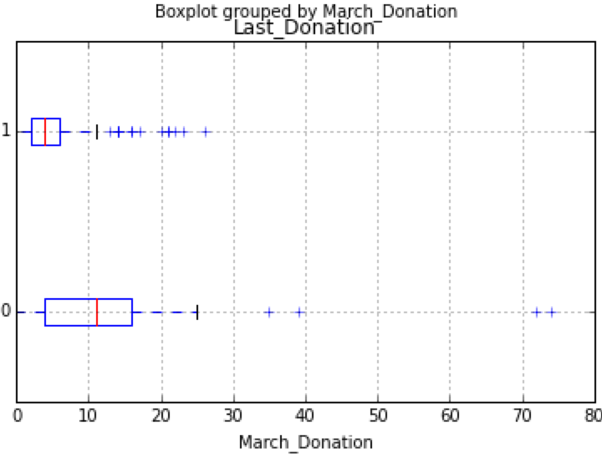
2. What’s the data?
Data Source: UCI Machine Learning Repository
Taiwanese mobile blood transfusion center
Training and Test data sets provided
Existing Features:
1) months since last donation
2) total number of donation
3) total blood donated (cc)
4) months since first donation.
Outcome:
Did the individual donate blood in March 2007?
Binary: Yes = 1, No = 0
What new, informative features can be derived from existing features? Donation interval? Non-linear features?
Do you think the data will enable to develop a effective model? Donor data would be tremendously useful

Slide 3
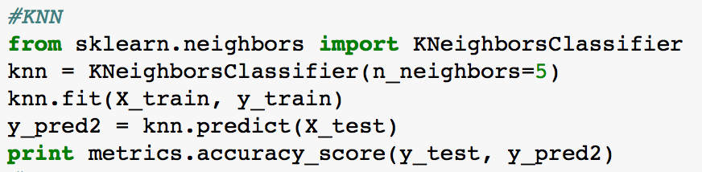
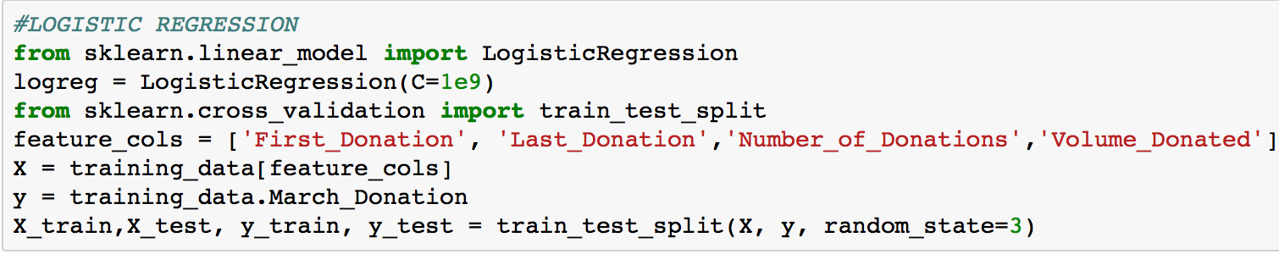
3. What’s next?
Is there actually a difference between donors and non-donors across these features?
Descriptive statistics using pd.groupby
Corresponding box plots
Initial models
KNN – neighbors = 5
Logistic regression
Cross-validation for KNN
What other evaluation metrics would be informative?
Can new features be introduced?

